Slide 1
HireAC
YOUR HOW TO GUIDE

Slide 2
HireAC Guide Sections
Getting Started with HireAC
Cooperative Education Module in HireAC
Changing Preferred Name in HireAC
Downloading the Co-op Work Permit Confirmation Letter
Co-op Documents Page in HireAC
Co-op Job Postings Page in HireAC
Setting up Job Alerts in HireAC
Co-op Interviews Page in HireAC
Co-op Job Offers in HireAC
Co-op Work-term record in HireAC
Booking a Peer Review meeting in HireAC
Events And Workshops Module in HireAC
Career & Employment Module in HireAC

Slide 3
5. Co-op Documents Page in HireAC
How to upload your resume and cover letter to HireAC and create a job application package

Slide 4
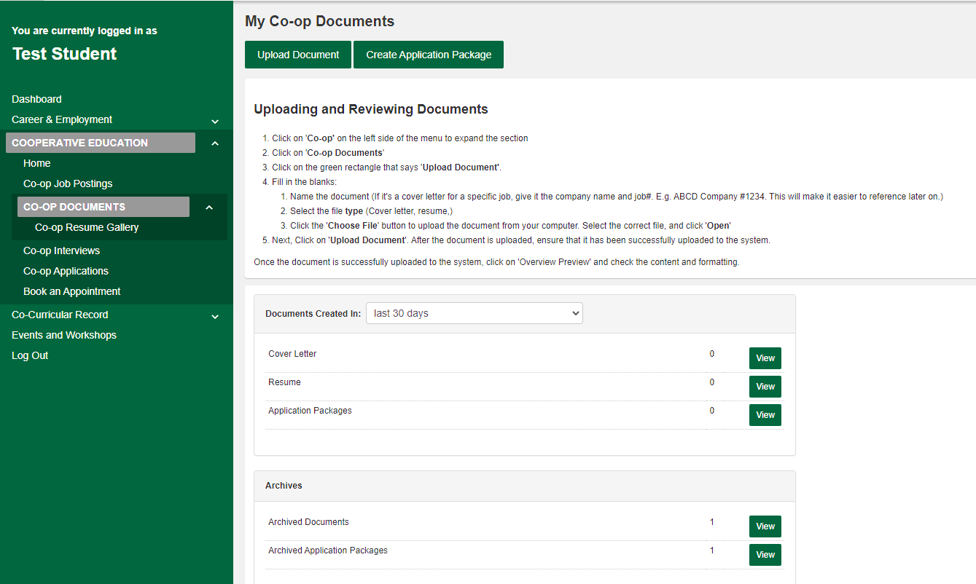
Uploading your Resume and Cover Letter to HireAC
Go to HireAC, Co-op module
Click on the Co-op Documents tab
Click on Upload Document to upload your:
Resume
Cover Letter
3
1
2

Slide 5
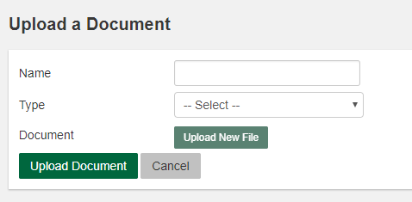
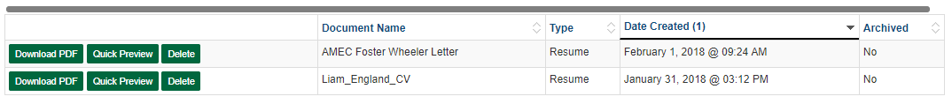
Uploading your Resume and Cover Letter to HireAC
Name your document; please consider using the following naming structure for your documents.
Resume: jobtitle_companyname; Cover Letter: jobtitle_companyname
Select the document Type from the drop-down list.
Click Upload New File and select the document you saved on your computer. Click Upload Document.
Your document will appear under Documents. Click on the Quick Preview to view and check the content and formatting.
Please note: HireAC does not have a section for uploading a transcript. If a transcript is requested as part of your application, please include it as an additional page to your resume.
1
2
4
3

Slide 6
Upload your Portfolio
A Portfolio is an effective self-marketing tool that contains a collection of your work, skills and accomplishments organized in a visually appealing, professional and creative way.
Employers who require students to include a portfolio as part of their applications, will also indicate this as a requirement in their job posting(s).
A Portfolio can be a Website URL or a PDF.
Website (Suggested Method)
Use online tools, such Adobe Express (formerly Adobe Spark) or Github to organize your work samples
Add the website URL to your resume header
Upload your resume to HireAC
PDF
Create a PDF with your samples work
Add this PDF as an additional page to your resume and upload your resume to HireAC
Your PDF can not be larger than 1MB

